Slide 1
AI and the Law: Considerations for Government Lawyering
Abdi Aidid
University of Toronto Faculty of Law
a.aidid@utoronto.ca

Slide 2
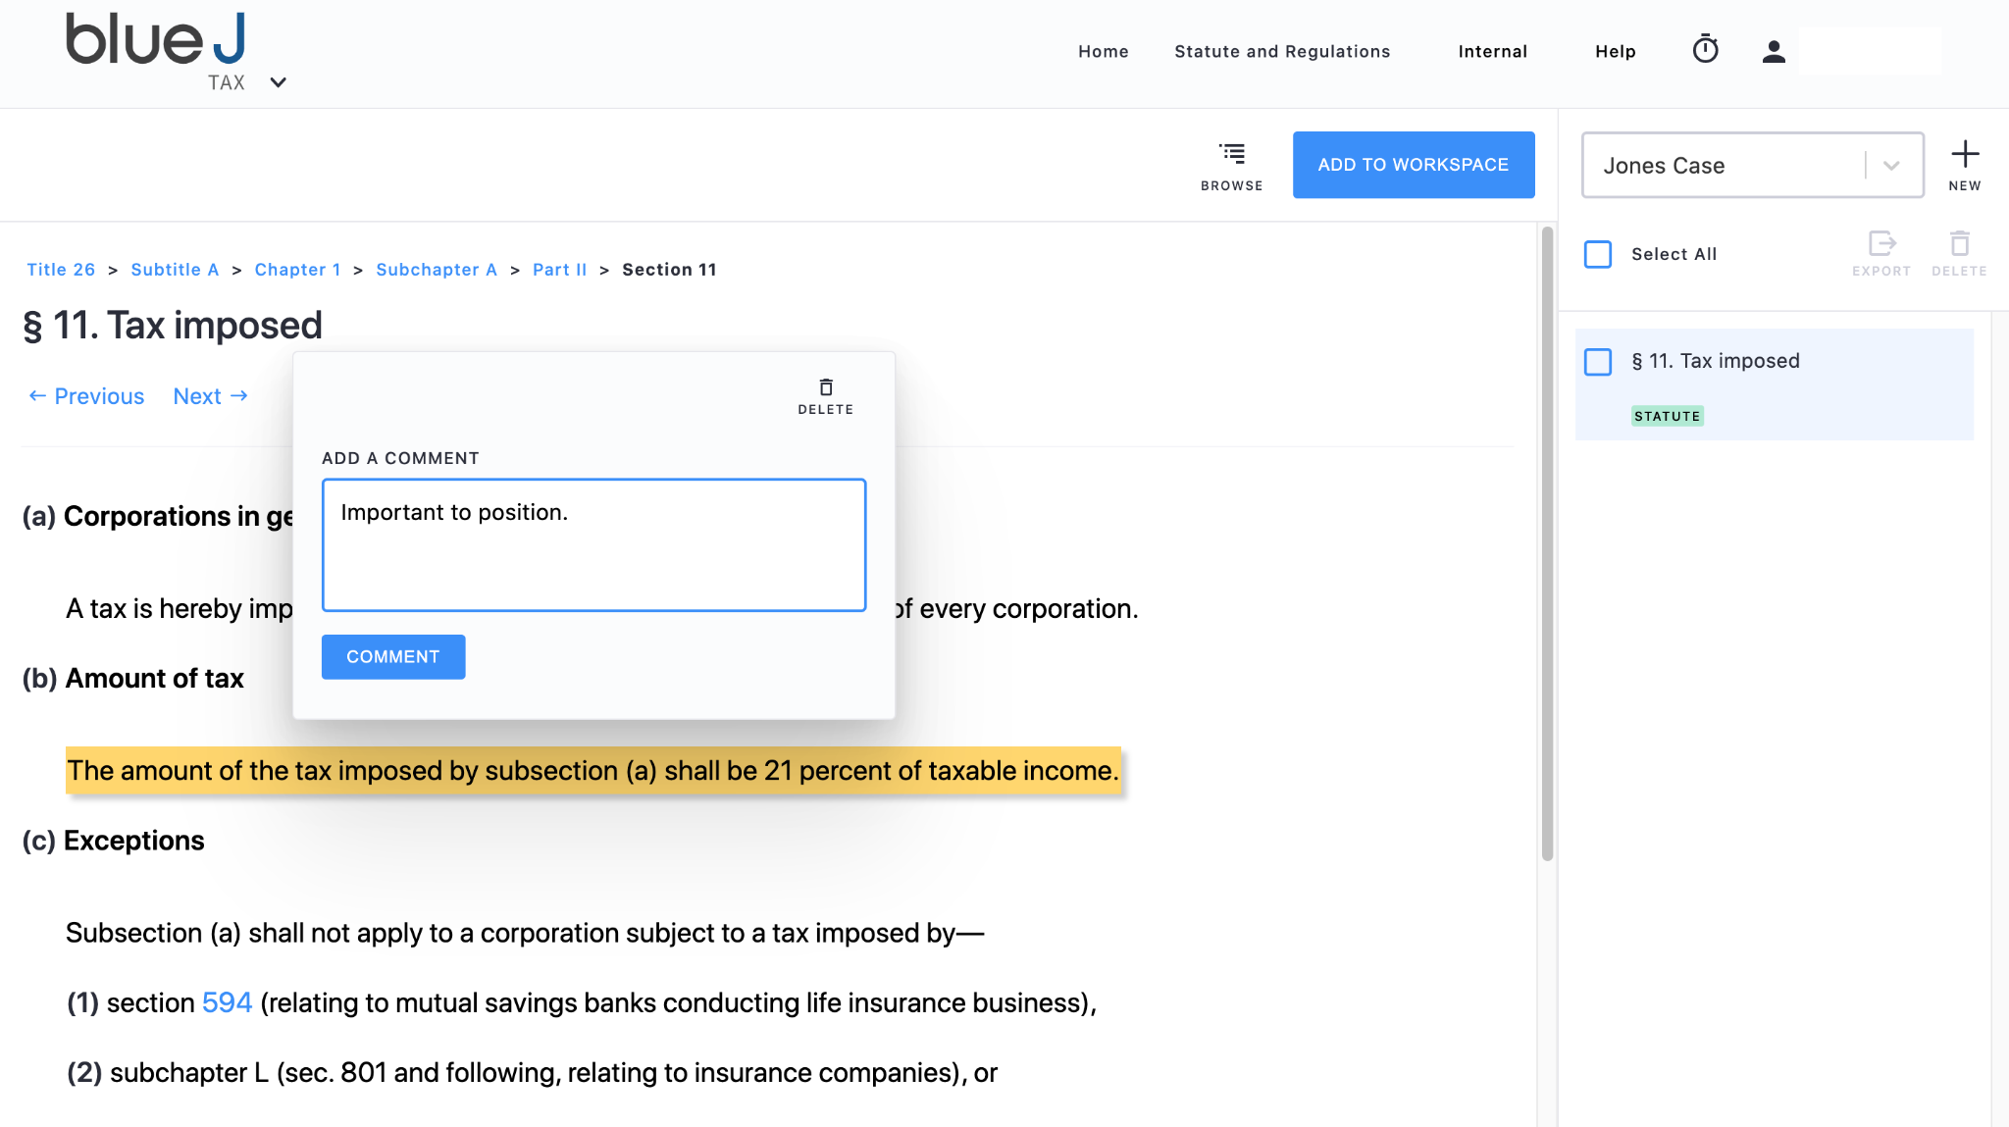
Statute Analysis

Slide 3
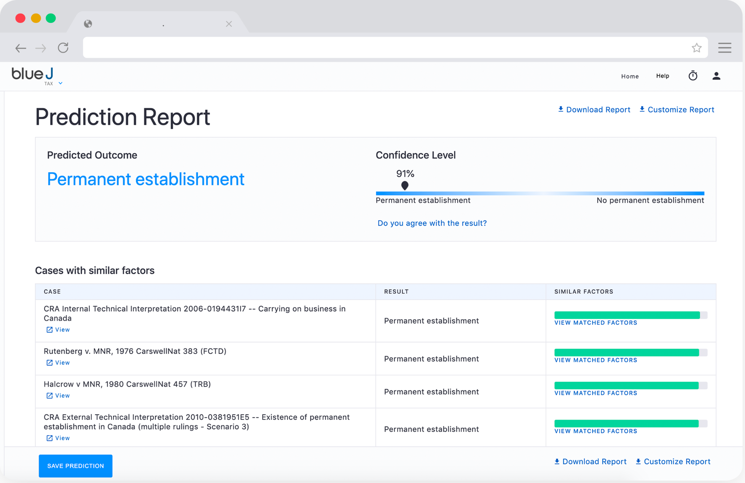
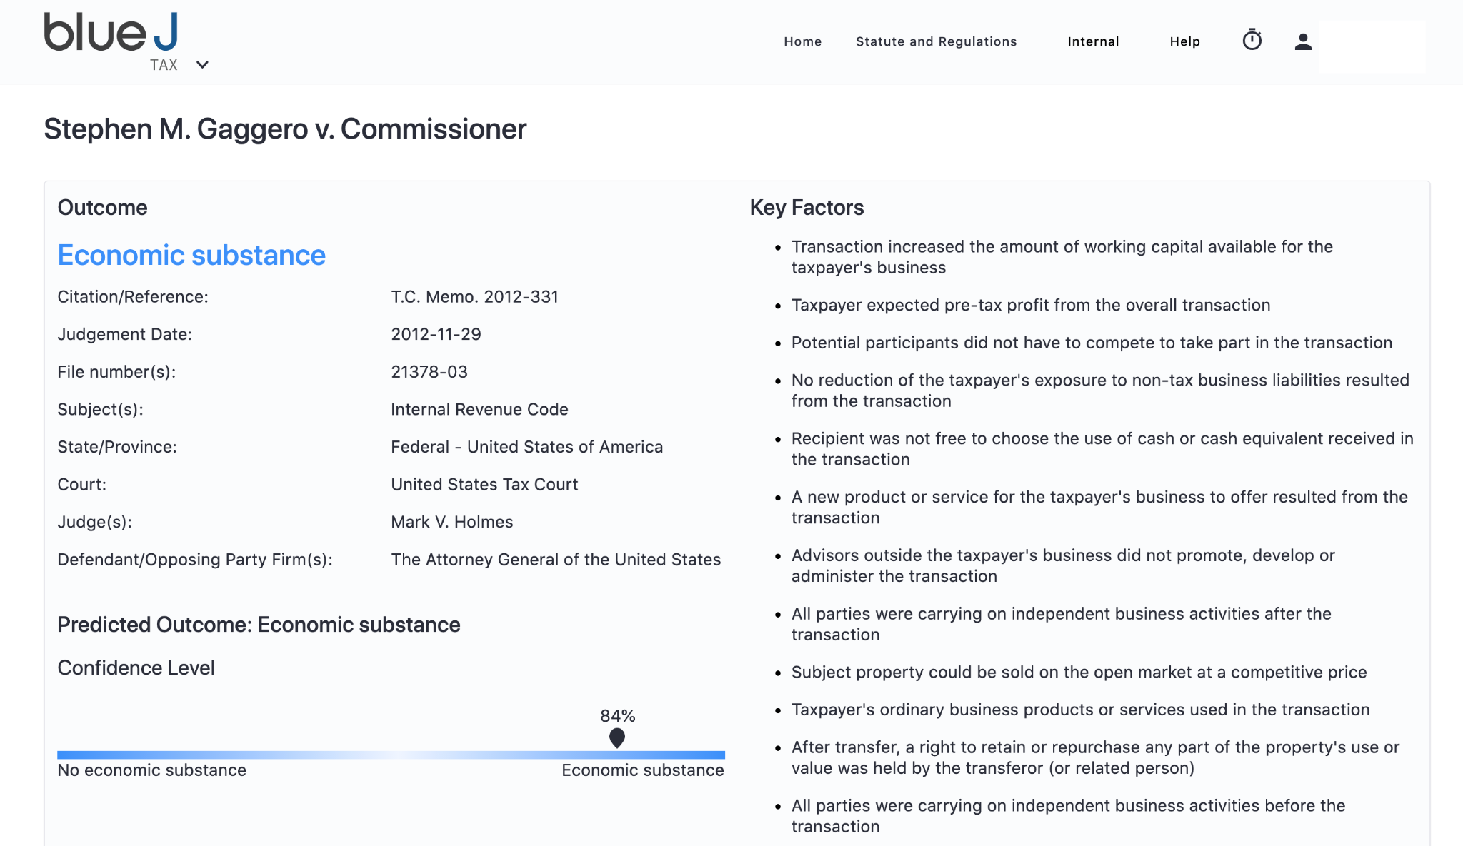
Intelligent Case Search

Slide 4
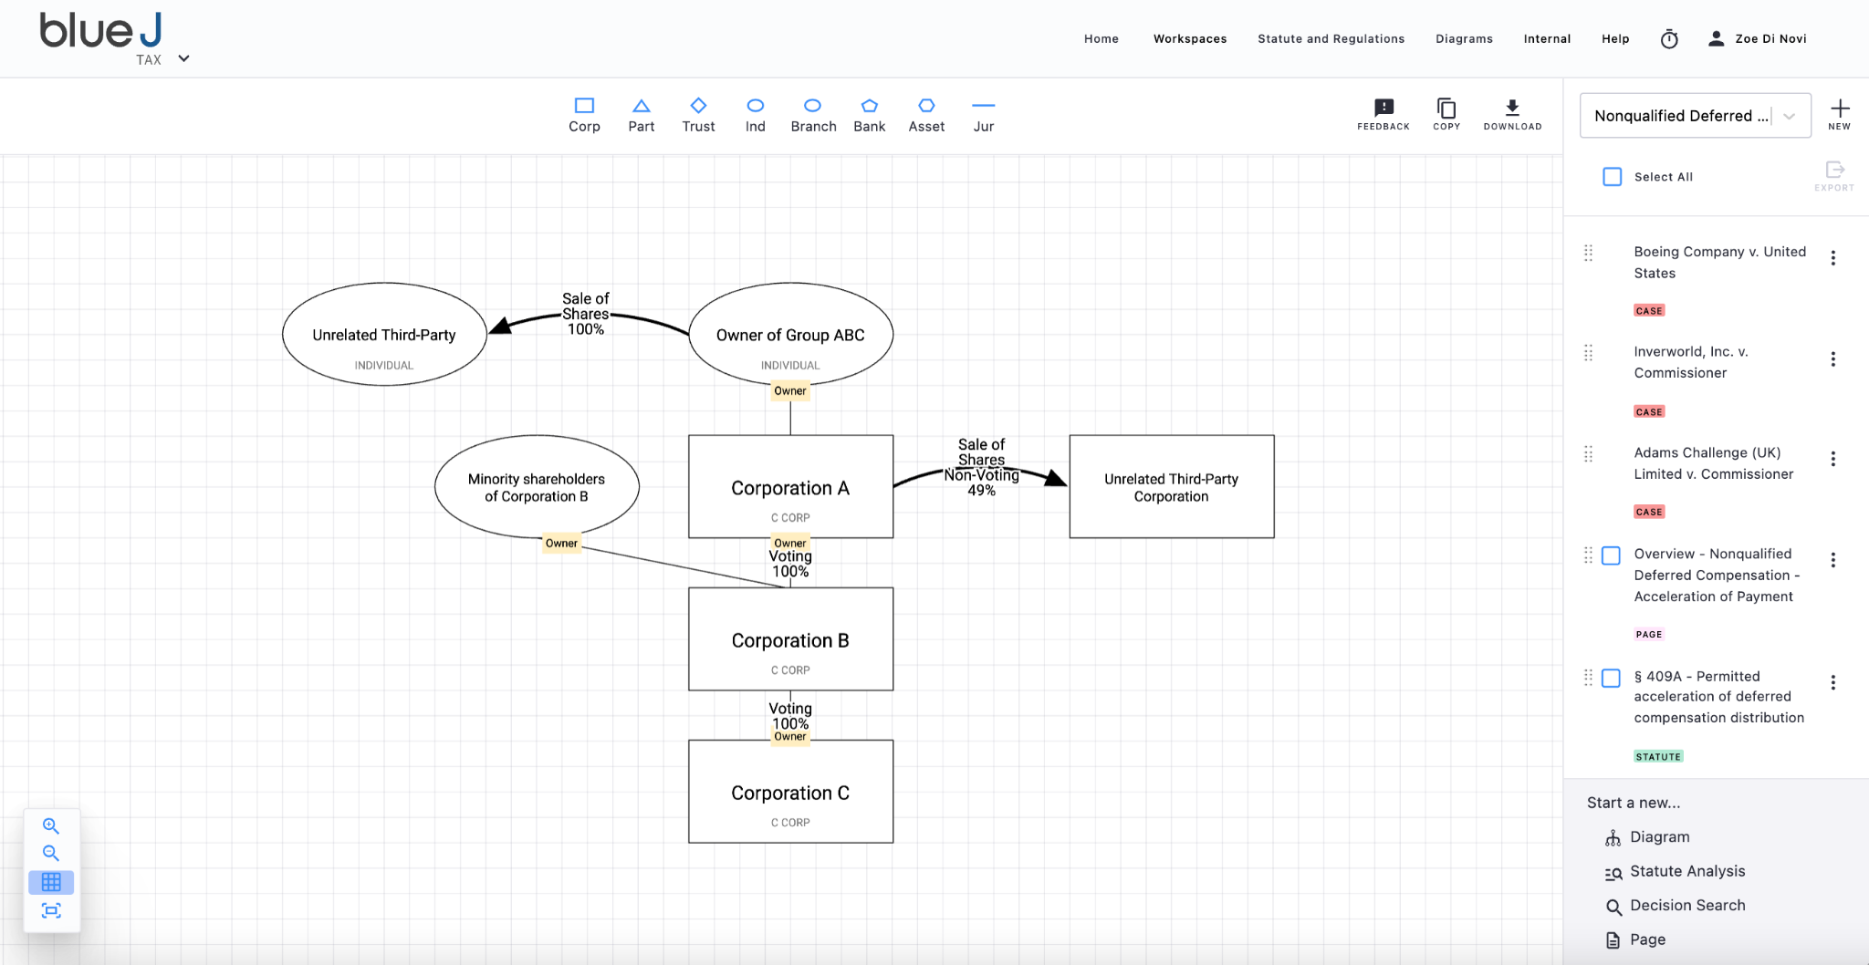
Relationship Diagramming

Slide 5
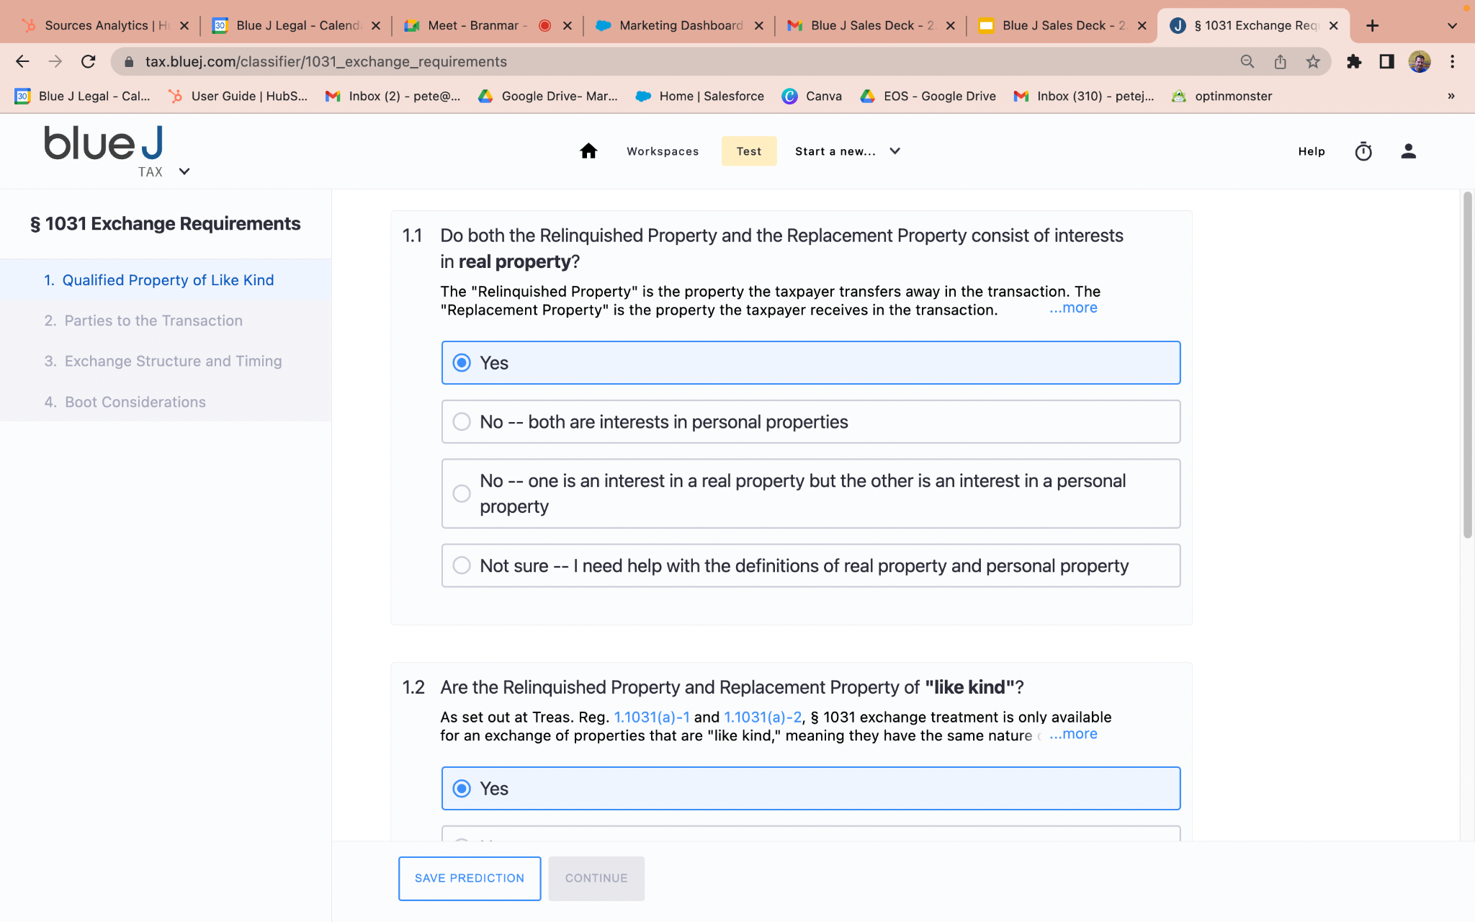
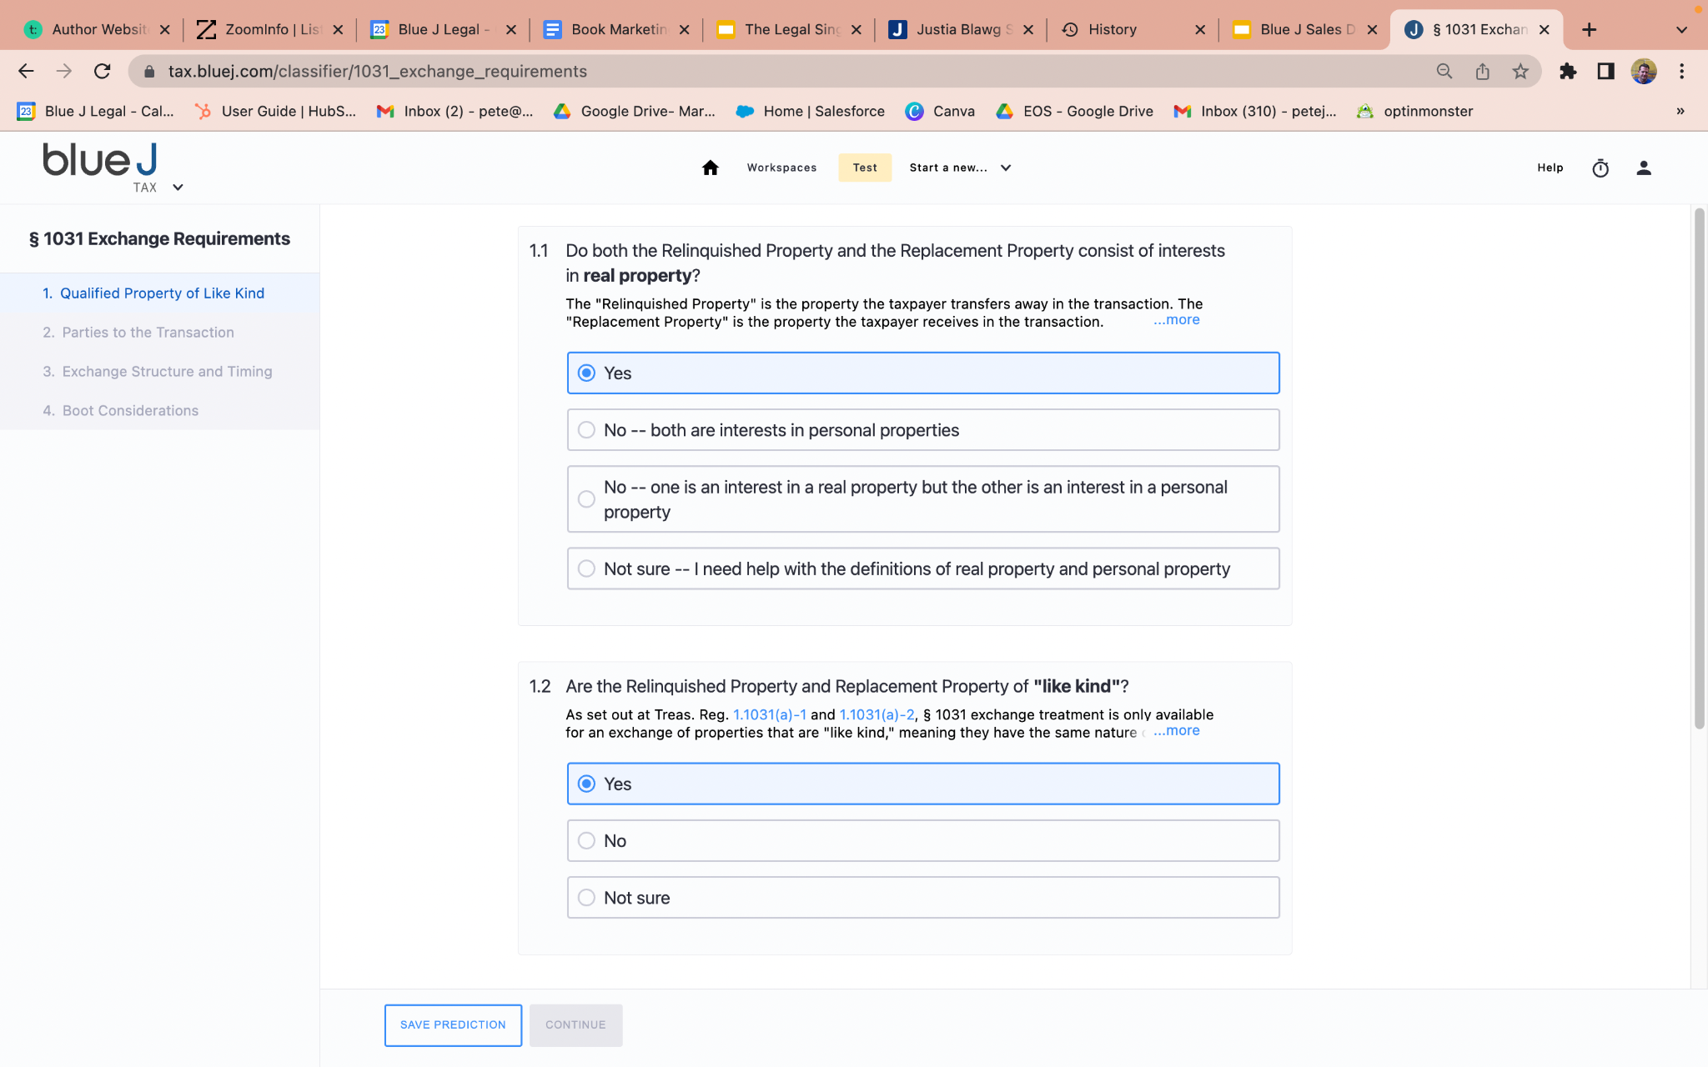
…but also CASE PREDICTION!

Slide 6


Slide 8




?
Begin with question of law
Determine
critical factors
Process legal materials
Apply, test &
refine algorithms
Monitor & process
new rulings
08

Slide 9
Timeline of Legal Information / Research
Analog
(Pre-1970s)
Digital
(1970s – 2015)
Computational
(2015 - )

Slide 10
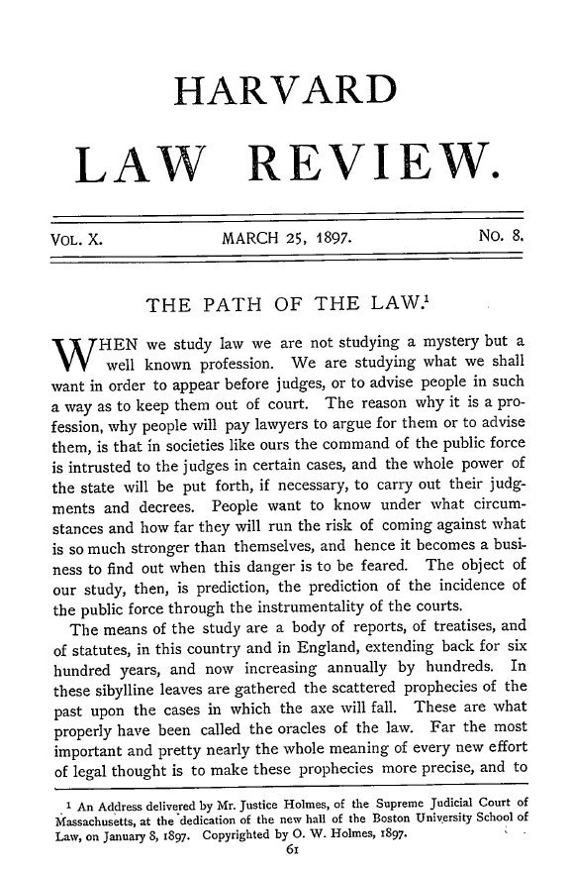
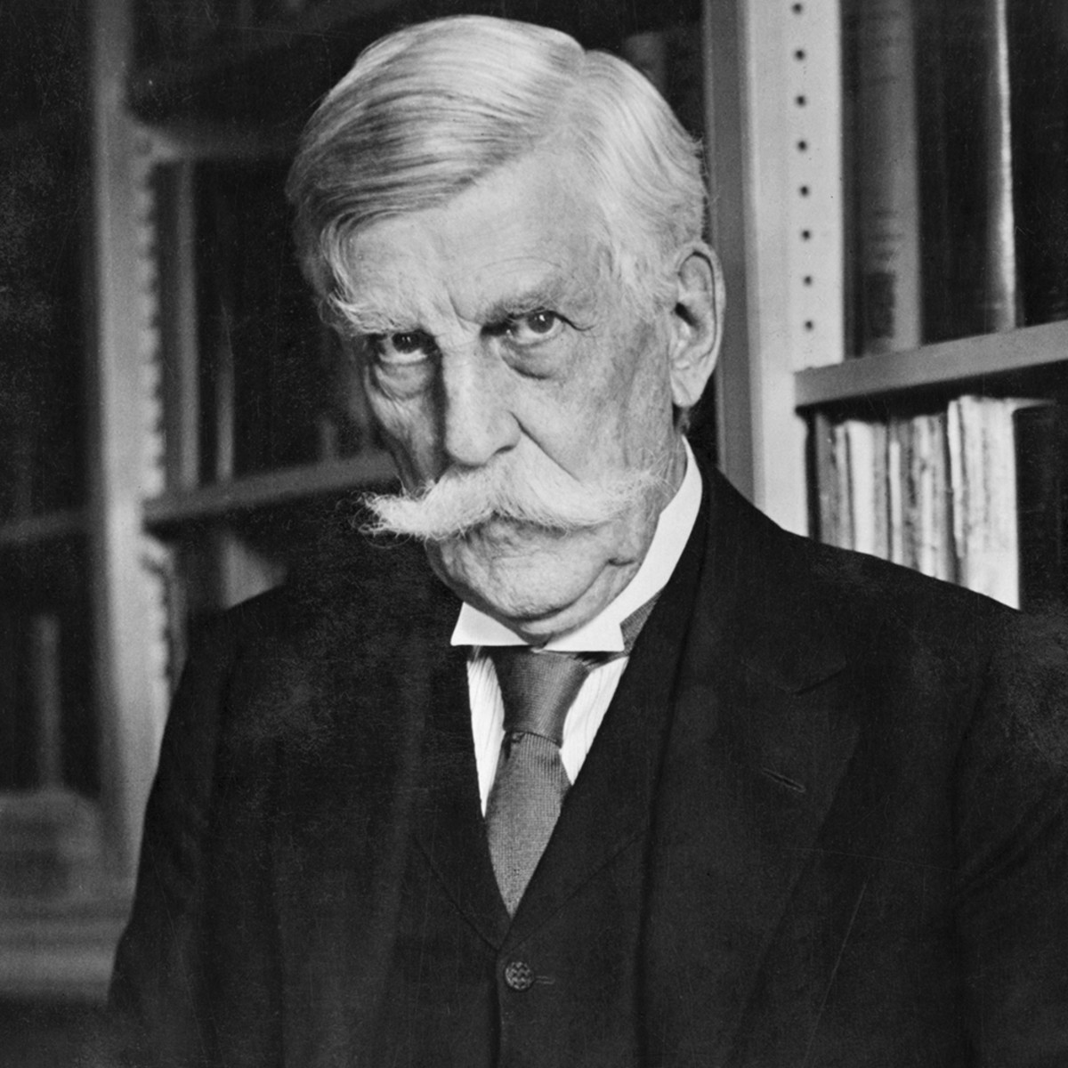
Law’s Long-Held Aspiration?
“The prophecies of what the courts will do in fact, and nothing more pretentious, are what I mean by the law.”
— Oliver Wendell Holmes Jr., “The Path of the Law” (1897)
010

Slide 11


More legal sophistication around AI
Personal Information and Data Protection Tribunal Act
PIPEDA
Consumer Privacy Protection Act
Artificial Intelligence and Data Act
(Not in force)

Slide 12
AI’s Opportunities
Improved dispute resolution
Universal legal literacy
Evolved lawyering
More rigorous debate
Fairer, better law

Slide 13
A framework for evaluating harm
Technological Problems
Disruption Problems
Reflection and Amplification Problems

Slide 14


Slide 15
